Slide 1



CPU Scheduling using C
Made by Team Electrocube
Himaneesh Singh
Nikhil Saini
Shambhav Chaudhary
Srivatsan Karthikeyan

Slide 2




Brief Description
Problem Statement: The Scheduler’s Path
Through this PowerPoint Presentation, we have tried to explain the different types of Algorithms we have implemented through Code with the help of C Programming Language. We show the Pseudocode or rather the Approach we have taken to implement the code before writing the actual code. The Problem Statement gave us 3 algorithms and we also implemented 3 extra algorithms on our own which have not been mentioned in the Problem Statement itself.

Slide 3
Algorithms Implemented
Problem Statement Algorithms:
First Come First Serve (FCFS)
Shortest Job First (SJF)
Round Robin (RR)
Algorithms Implemented on our Own:
Shortest Remaining Job First (SRJF)
Longest Job First (LJF)
Multi-Level Queue (MLQ)

Slide 4
Algorithms Explained (Problem Statement)
First Come First Serve (FCFS): FCFS stands for First Come First Served (FCFS). First Come First Served (FCFS) is the simplest type of algorithm. It is a non-preemptive algorithm i.e. the process cannot be interrupted once it starts executing. The FCFS is implemented with the help of a FIFO queue. The processes are put into the ready queue in the order of their arrival time.
Shortest Job First (SJF): SJF stands for Shortest Job First (SJF). Shortest Job First (SJF) Scheduling Algorithm is based upon the burst time of the process. The processes are put into the ready queue based on their burst times. In this algorithm, the process with the least burst time is processed first.
Round Robin (RR): Round Robin is a CPU scheduling algorithm where each process is cyclically assigned a fixed time slot. It is the preemptive version of the First come First Serve CPU Scheduling algorithm.

Slide 5
Algorithms Explained (Own Initiative)
Shortest Remaining Job First (SRJF): The pre-emptive version of Shortest Job First (SJF) scheduling is called Shortest Remaining Job First (SRJF). In SRJF, the process with the least time left to finish is selected to run. The running process continues until it finishes or a new process with a shorter remaining time arrives, ensuring the fastest finishing process always gets priority.
Longest Job First (LJF): Longest Job First (LJF) is a non-preemptive scheduling algorithm. This algorithm is based on the burst time of the processes. The processes are put into the ready queue based on their burst times i.e., in descending order of the burst times. As the name suggests this algorithm is based on the fact that the process with the largest burst time is processed first. The burst time of only those processes is considered that have arrived in the system until that time.
Multi-Level Queue (MLQ): Multilevel Queue (MLQ) CPU scheduling is a type of scheduling that is applied at the operating system level with the aim of sectioning types of processes and then being able to manage them properly. As with the MQ Series, processes are grouped into several queues using MLQ based on known parameters such as priority, memory, or type. Every queue has its scheduling policy and processes that are in the same queue are very similar too.

Slide 6


Slide 7
First Come First Serve (FCFS) Pseudocode

Slide 8
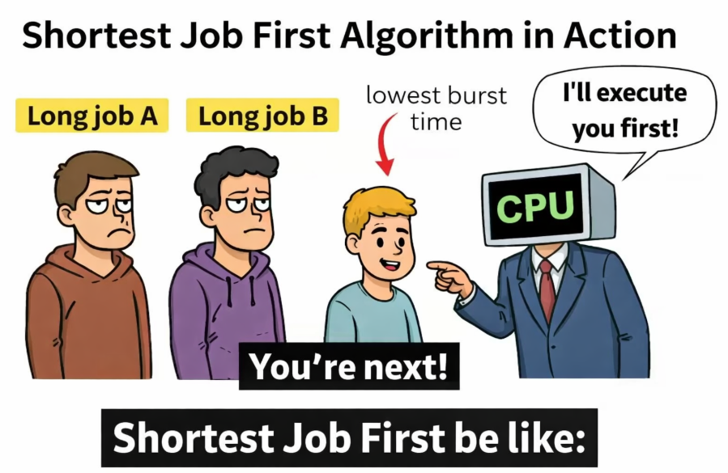

Slide 9
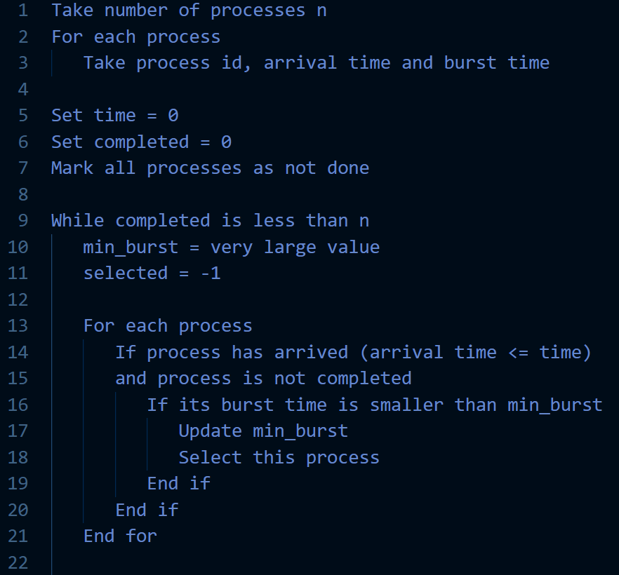
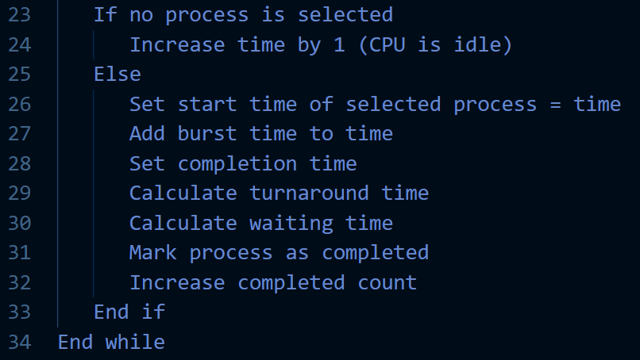
Shortest Job First (SJF) Pseudocode

Slide 10
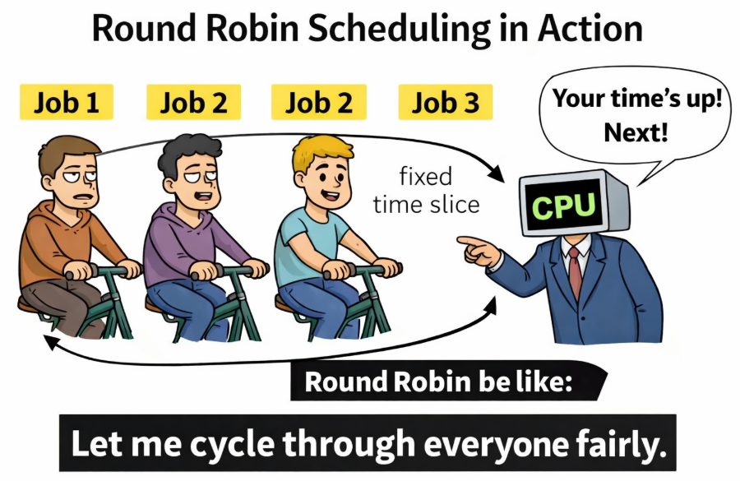

Slide 11
Round Robin Pseudocode

Slide 12
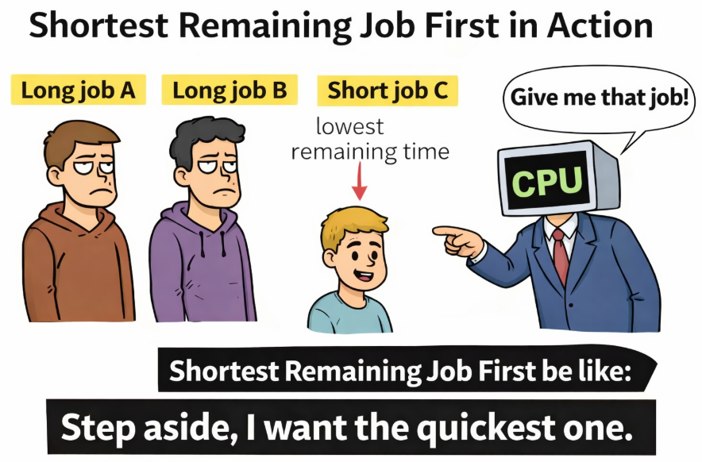

Slide 13
Shortest Remaining Job First (SRJF) Pseudocode

Slide 14
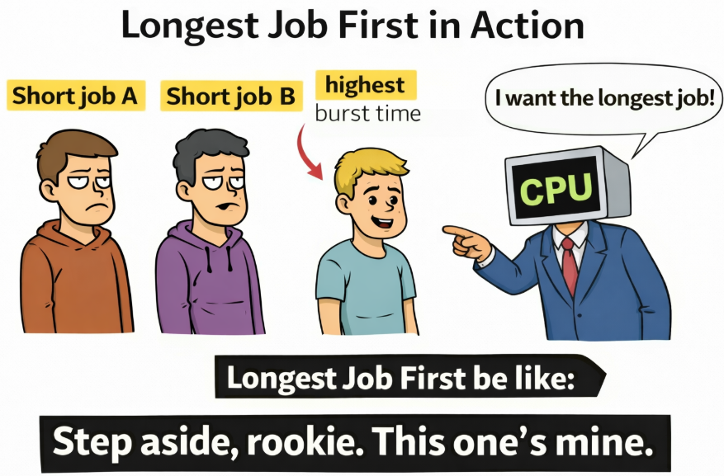

Slide 15
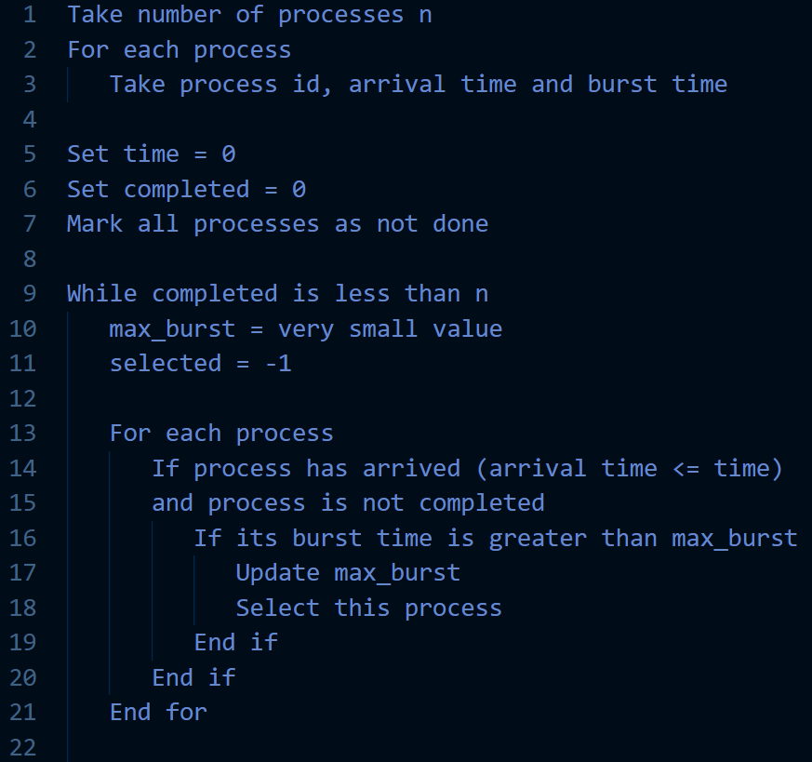
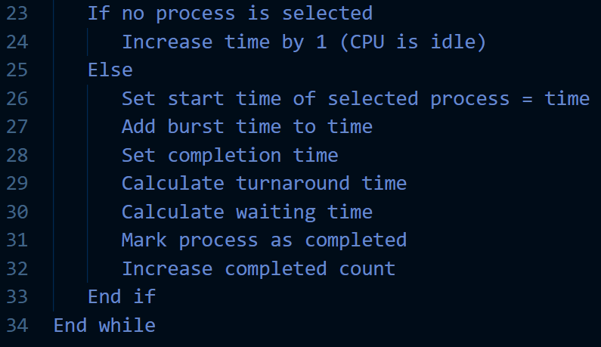
Longest Job First (LJF) Pseudocode

Slide 16


Slide 17
Multi-Level Queue (MLQ) Pseudocode

Slide 18
References
https://www.geeksforgeeks.org/

Slide 19

